Slide 1
Welcome to Serve-Learn-Sustain (SLS)
Georgia Tech’s Quality Enhancement Plan (QEP)
Launched in January 2016

Slide 2
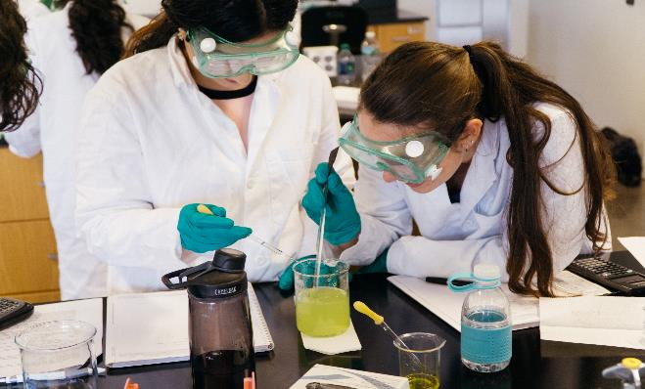
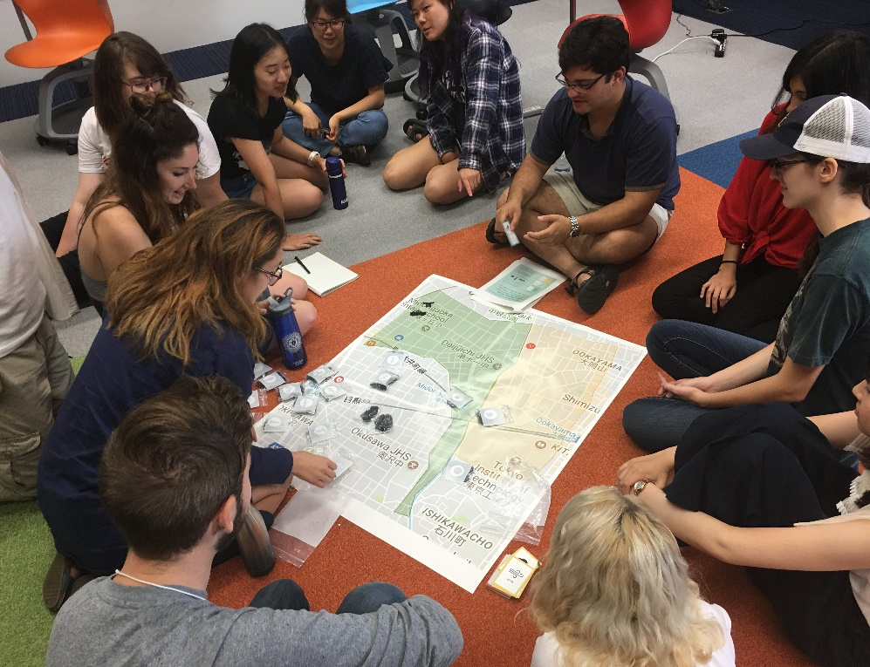
What Does SLS Do?
SLS works with all six colleges to offer students opportunities inside and outside the classroom to collaborate with diverse partners - across the community, nonprofit, government, academic, and business sectors – on key sustainability challenges.
Through SLS, students learn to use the knowledge and skills they are acquiring at GT to help “create sustainable communities.”

Slide 3
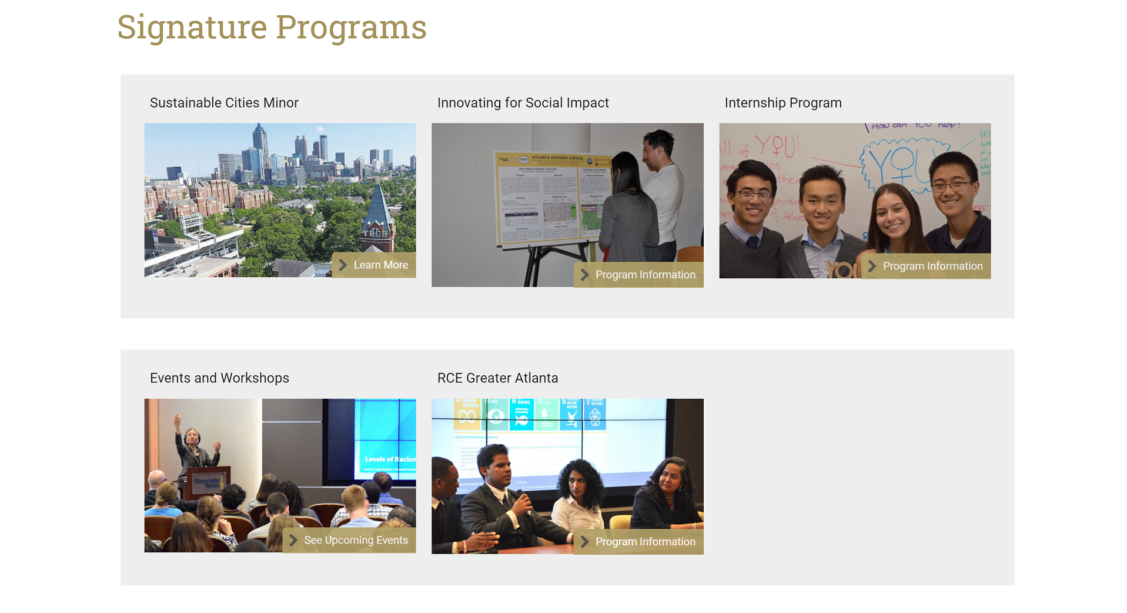
SLS Programs
SLS offers 5 signature programs with different levels of commitment:

Slide 4
SLS Programs
We also offer these additional courses and programs:

Slide 5
SLS’s Approach to “Creating Sustainable Communities”
SOCIETY
SLS approaches sustainability:
Societal/ Economic
Societal/
Environmental
as an Integrated System
with a special focus on Society/Social Sustainability
ECONOMY
ENVIRONMENT
Economic/
Environmental

Slide 6
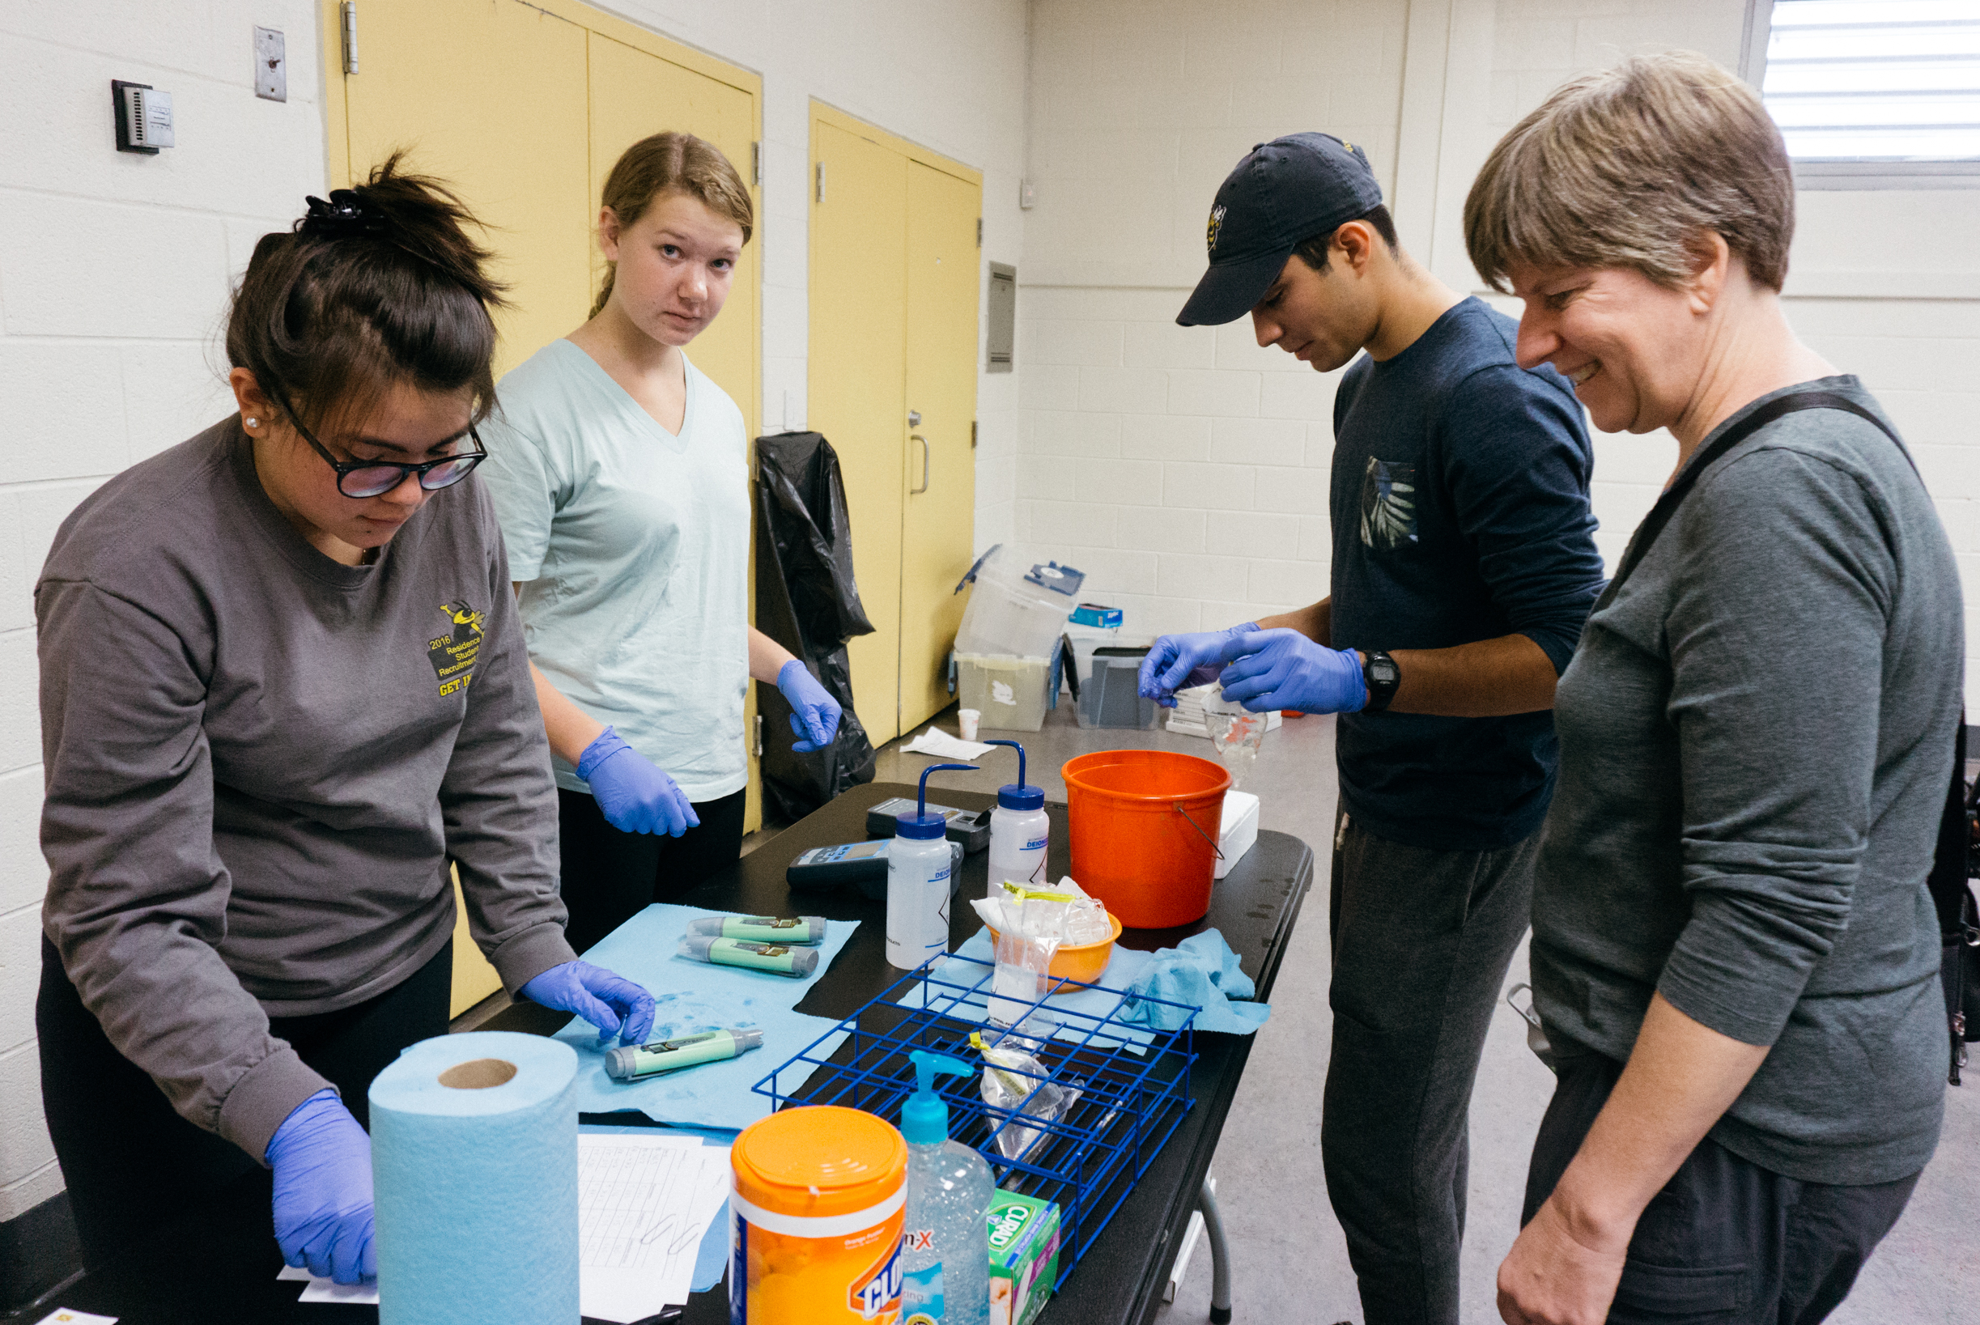
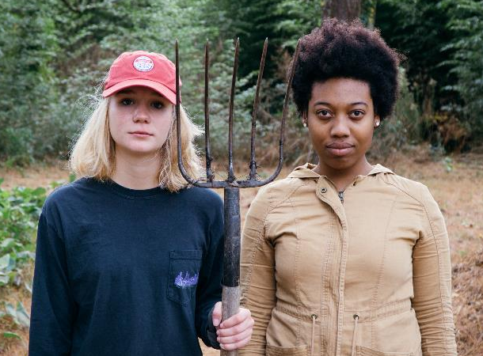
SLS’s Approach to “Creating Sustainable Communities”
SLS programs focus on these priority sustainable communities issues:
Community Health
Equitable & Sustainable Development
Green Infrastructure
Climate Change & Energy

Slide 7
SLS’s Approach to “Creating Sustainable Communities”
We work with communities as collaborators, rather than clients.
Increasing level of community involvement, impact, trust and communication
From Schematic of Community Engagement Continuum (EPA, 2015; NCER CEnR Primer; note that this is one piece of a larger diagram)

Slide 8
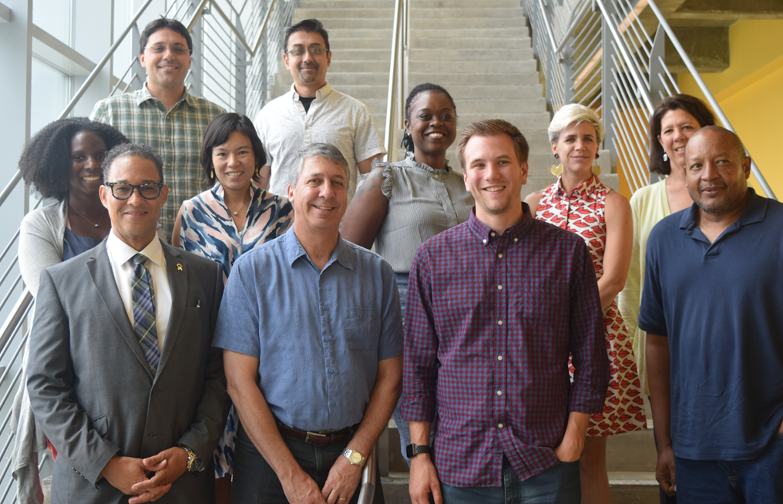
Our Partnership Principles
Start with assets
Focus on equity and justice
Champion systems change
Support community innovators
Prioritize process before outcomes
Contribute to the neighborhood
Apply technology in social context
SLS 2019 Partnership Advisory Council
Read the SLS Partnership Strategy

Slide 9
SLS’s Approach to “Creating Sustainable Communities”
SLS approaches technology as a tool to support community visions that benefit society and nature
AF2 Retreat attended by GT ME capstone team, Fall 2018

Slide 10
The Ultimate Goal is to Create Sustainable Communities Where People & Nature Flourish
SOCIETY | ECONOMY | ENVIRONMENT
Address basic needs and advance equity | Nurture vibrant, diverse economies | Protect natural resources
Nurture civic participation and amplify community voices | Support local innovation, entrepreneurship, and ownership | Preserve and restore biological diversity
Strengthen social ties and other connections to place |  | Reduce energy use
Bolster human capital |  | Manage and recycle waste
Preserve cultural diversity
SOCIETY
Societal/ Economic
Societal/
Environmental
ECONOMY
ENVIRONMENT
Economic/
Environmental

Slide 11
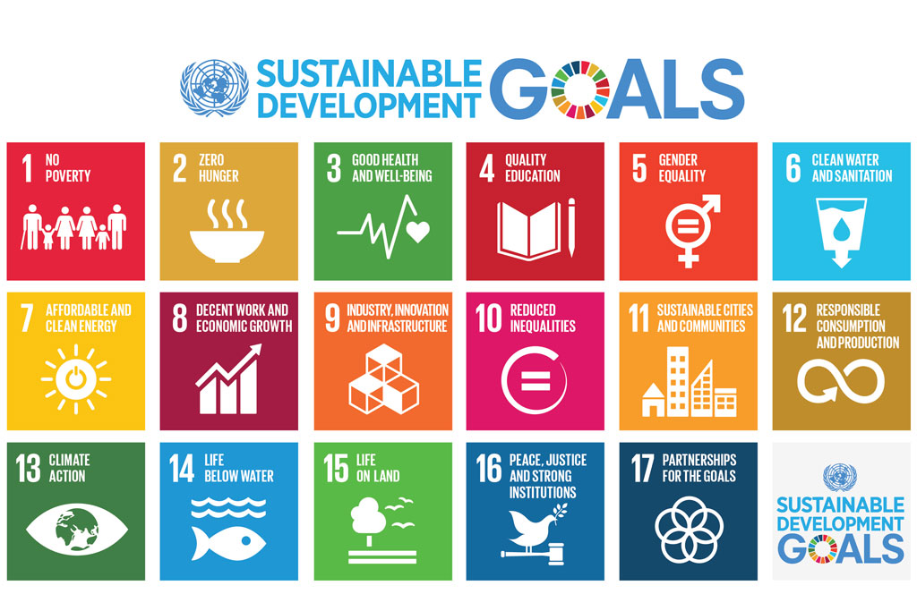
We Aim to: ACT LOCAL TO ACHIEVE A GLOBAL VISION – UN SDGs

Slide 12
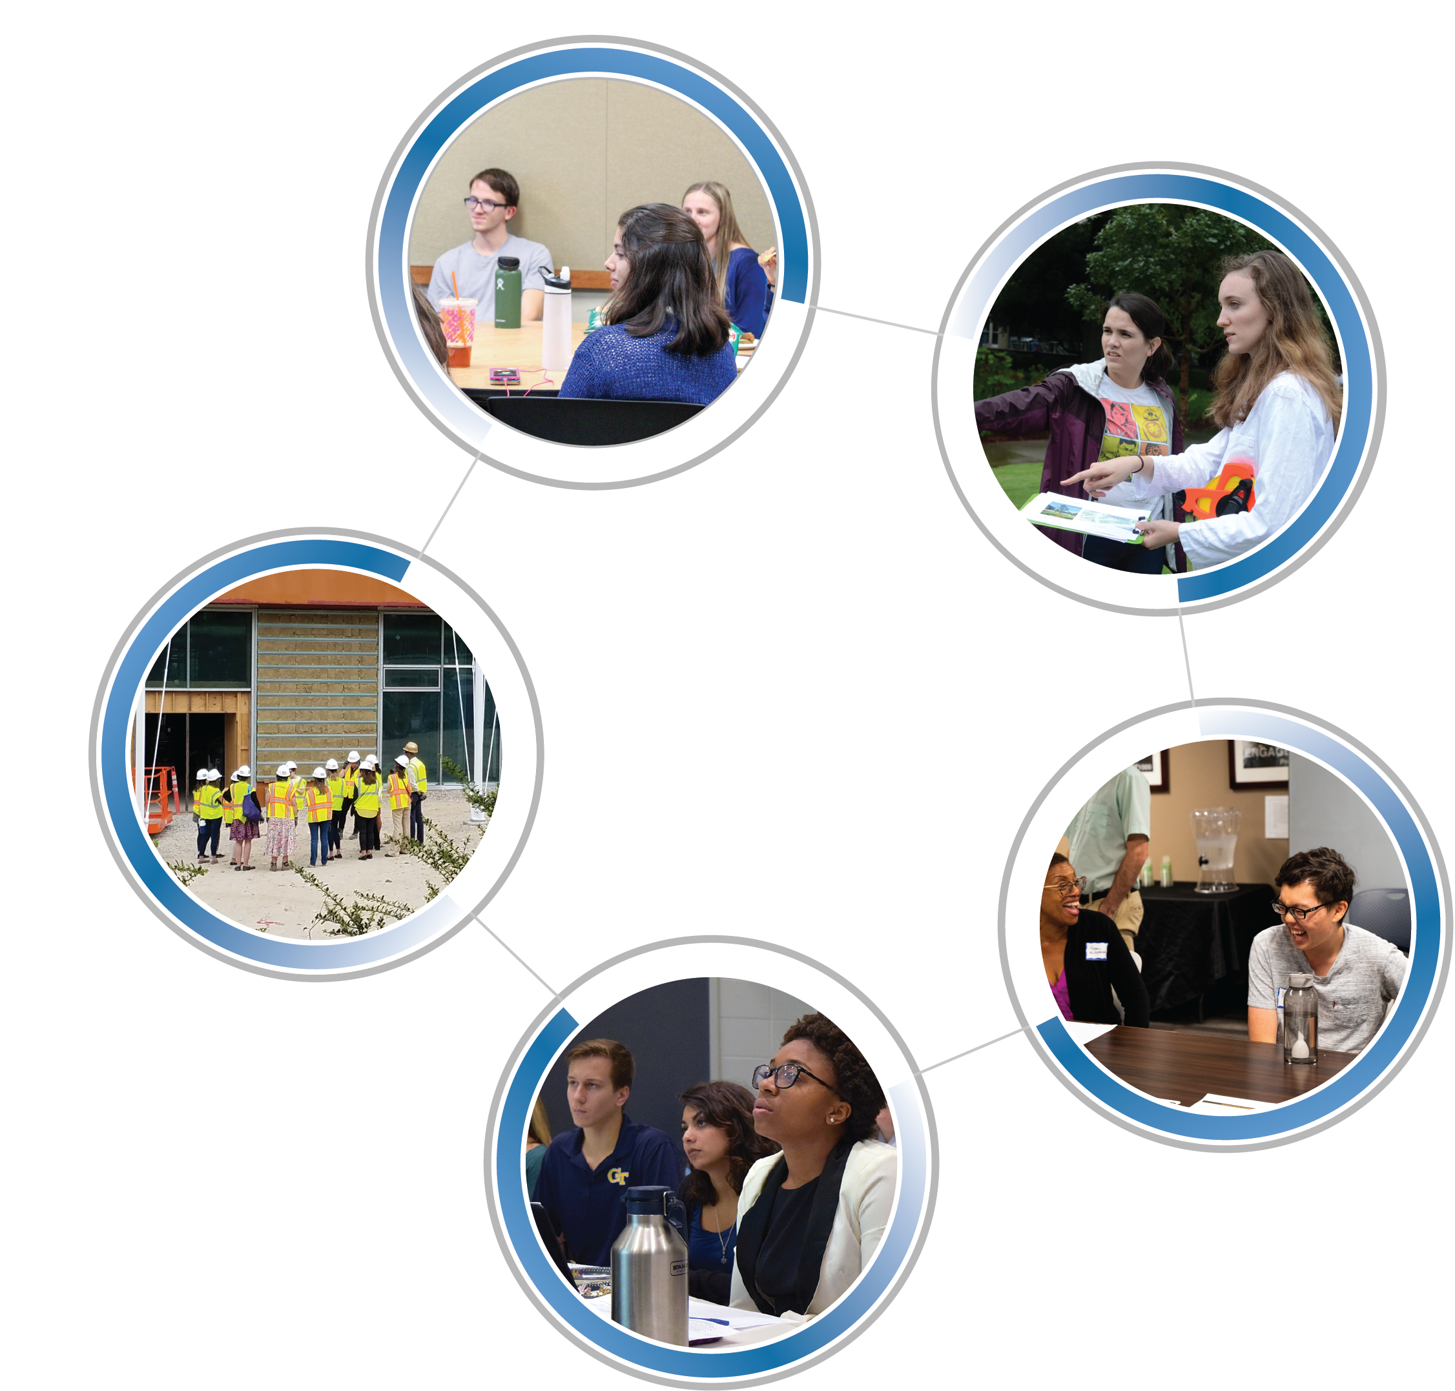
There Is a Place for You with SLS!
RCE Action Groups (Youth Engagement)
Internships
Buzz Courses
Sustainable Cities Minor
SLS-affiliated
Capstone Projects

Slide 13
Learn More About SLS
Visit the SLS website:
www.serve-learn-sustain.gatech.edu
Subscribe to the SLS email list:
http://sls.gatech.edu/mailing-list/register
Contact us – we’d love to talk to you!
serve-learn-sustain@gatech.edu

